Slide 1
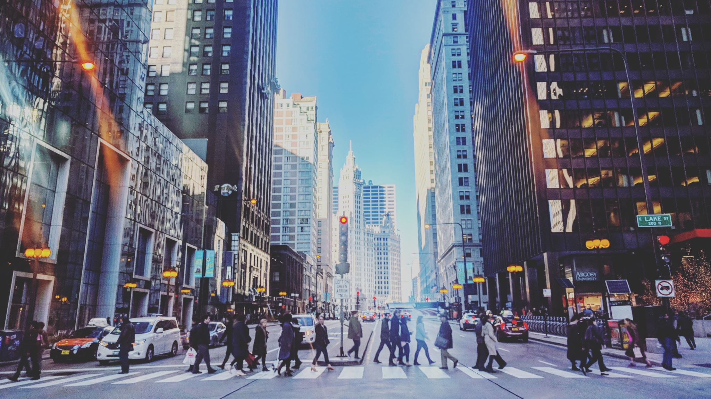
THE BATTLE OF NEIGHBORHOODS: Chicago, Illinois
Submitted by:
Garima Singhal

Slide 2

INTRODUCTION
Chicago, Illinois is one of the most populous big cities in the United States. It is famous for its bold architecture, consisting of skyscrapers such as Willis Tower, John Hancock Center, and the Tribune Tower. The city is renowned for its museums, and art galleries. It is also one of the greatest hubs for business, education, industry, culture, transportation, and a lot more. The city is highly diversified with people from all backgrounds and cultures making it the most balanced economy in the United States.
Chicago being one of the cities embodying highly paid corporate jobs, we see that more people are moving into the city every day. Considering Chicago, which has an overall crime rate higher than the US average, it becomes challenging to find a good and safe neighborhood.

Slide 3

BUSINESS PROBLEM
In 2016, the city saw a surge in gun violence with 762 murders, 3550 shooting incidents, and 4331 shooting victims which was more than the number of murders in New York City and Los Angeles, combined. The estimated number of homicides in Chicago increased by 52% in 2016.
To buy an apartment or a house, deciding which neighborhood you should choose is one of the most important decisions. Safety is the foremost priority when it comes to finding the right neighborhood and income being the second most important.
The aim of this project is to find a safe neighborhood based on the crime rate and per capita income in various neighborhoods across the city of Chicago. The goal of this project is to help new people move into the city and help them find a neighborhood which is safe, has a low crime rate and fits into their budget.

Slide 4

METHODOLOGY
Data Acquisition:
The data acquired for this project is a combination of data from three sources.
The first source of data is scraped from a Wikipedia page that contains the list of Chicago community area.
The second data source of the project uses a Chicago crime data that shows the crime per community area in Chicago.
Third data source is Chicago Census Data - Selected socioeconomic indicators in Chicago, 2008 – 2012. This dataset contains a selection of six socioeconomic indicators of public health significance and a “hardship index,” for each Chicago community area, for the years 2008 – 2012.

Slide 5

METHODOLOGY (CONT.)
Data cleaning and processing:
The data cleaning for each of the three sources of data is done separately.
The First data is scraped from a Wikipedia page using the Beautiful Soup package in python. Using this library we can extract the data in the tabular format as shown in the website.
The second data from the Chicago crime data, we only selected the crimes during the most recent year of 2020. The major categories of crime are segregated by community area number to get the total crimes per community area.
The third dataset Chicago Census Data - Selected socioeconomic indicators in Chicago, 2008 – 2012, we extracted the per capita income of each community area along with its community area number.

Slide 6
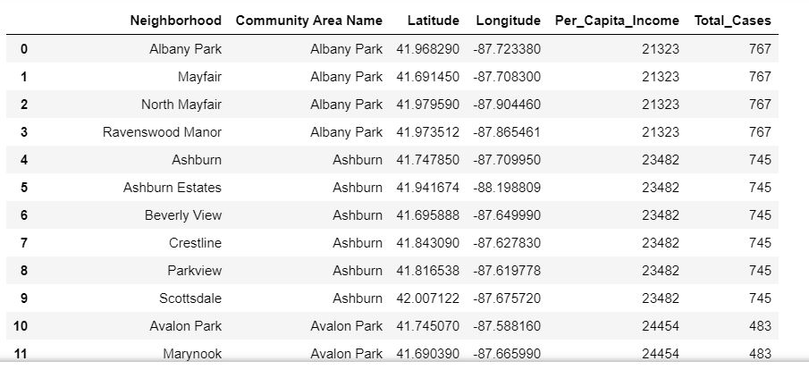
METHODOLOGY (CONT.)
Data cleaning and processing (Cont.):
The two datasets are merged on the Community area Names to form a new dataset that combines the necessary information in one dataset.
The coordinates of the neighborhoods are fetched using Geocoder package to create a final consolidated dataset of the Neighborhoods, along with the community areas, total crime cases, and per capita income.

Slide 7
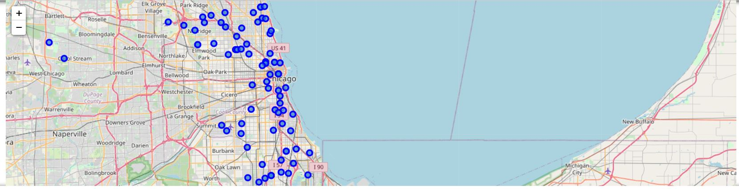
VISUALIZATION OF THE SELECTED NEIGHBORHOODS
Neighborhoods with low crime rate and high per capita income are selected.
The neighborhoods that satisfy the criteria are visualized using the Folium library in Python.

Slide 8
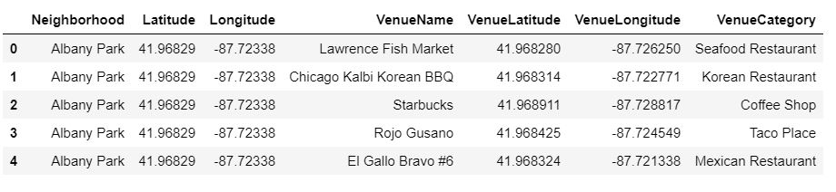
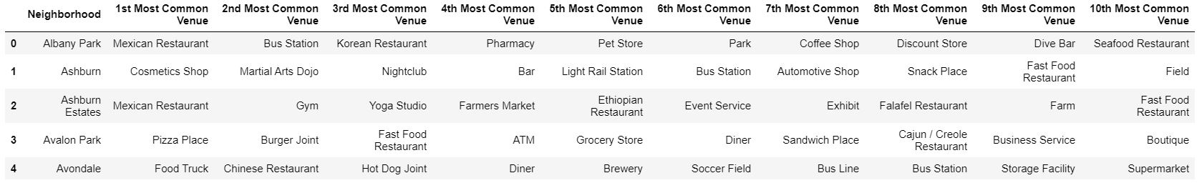
DATA MODELING
Using the final dataset containing the selected neighborhoods along with their latitudes and longitudes, we find all the venues within a 500-meter radius of each neighborhood by connecting to the Foursquare API.
One hot encoding is done on the venues data. The Venues data is then grouped by the Neighborhood and the mean of the venues are calculated, finally the 10 common venues are calculated for each of the neighborhoods.

Slide 9
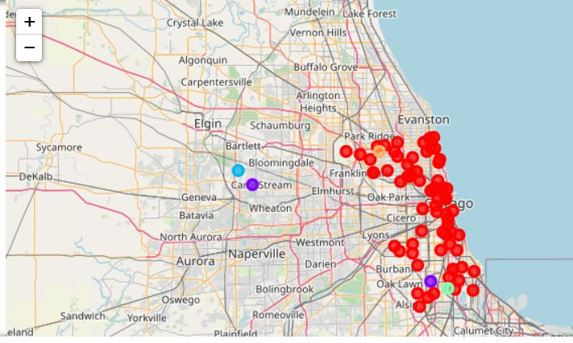
RESULTS
After running the K-means clustering we can access each cluster to see which neighborhoods were assigned to each of the five clusters. Visualizing the clustered neighborhoods on a map using the folium library in Python.
Each cluster is color coded for the ease of presentation.

Slide 10
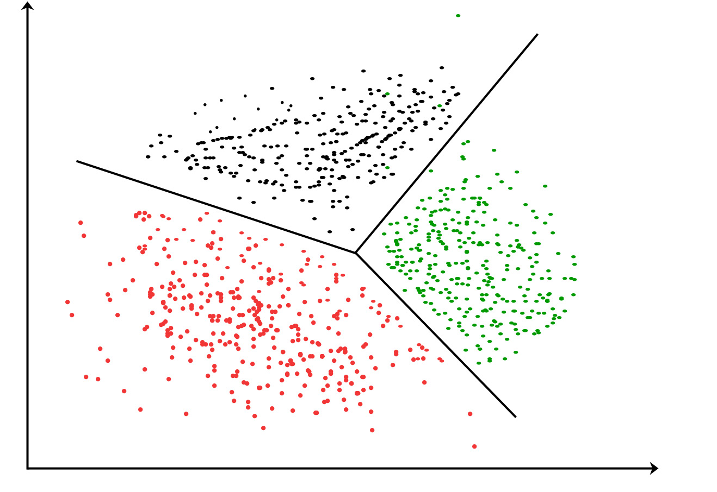
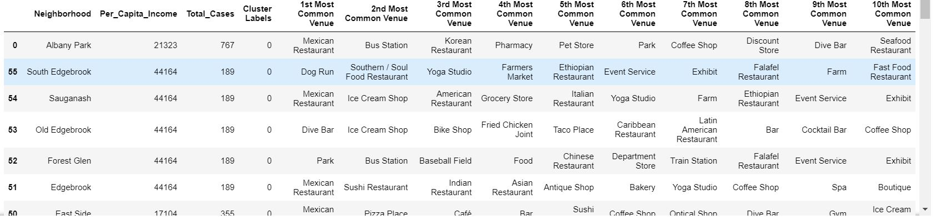
ANALYZING CLUSTERS
Cluster 1 : This cluster consists of the maximum number of neighborhoods spared across Albany Park, Edison Park etc. Upon closely examining these neighborhoods, we see that the most common venues in these neighborhoods are food joints, bar, café, bike shop, gym/yoga studio, pharmacy, grocery stores, parks etc.

Slide 11
ANALYZING CLUSTERS (CONT.)
Cluster 2: The second cluster consists of two neighborhoods Old Norwood and Beverly. The most common venues in these neighborhoods are parks, breakfast places, farmers market, electronics store, Ethiopian restaurant.
The third, fourth, and fifth clusters consist of just one neighborhood each. This is because of the unique venues in each of the neighborhoods, hence they could not be clustered into the similar neighborhoods.

Slide 12
ANALYZING CLUSTERS (CONT.)
Cluster 3: The most common venues in cluster three are a Mexican restaurant, gym/yoga studio, farmers market.
Cluster 4: The most common venues in cluster four are a convenience store, yoga studio, Ethiopian restaurant.
Cluster 5: The most common venues in cluster five are football stadiums, parks, yoga studio, farms.

Slide 13
DISCUSSION
We explored the city of Chicago, Illinois to find a best neighborhood in the city where the crime rate is lowest. We worked on Chicago crime data to understand various kinds of crimes in each community area of Chicago and later segregated them based on per capita income. This strategy helped us in selecting community areas with lower crime rate and higher per capita income. Once the community areas were short listed based on the lower crime rate and higher per capita income, consideration of neighborhoods became easier as the number of neighborhoods reduced. We further shortlisted the neighborhoods based on common venues, to choose a neighborhood which best suits the problem.

Slide 14
CONCLUSION
The objective of this project was to find a safe neighborhood in the city of Chicago, Illinois based on low crime rate and high per capita income. This was achieved by analyzing the Chicago crime data to find a safe community area and by analyzing the Chicago Census Data for determining the per capita income of each of the community areas. After the selection of the community area based on the two factors: lower crime rate and higher per capita income, it was vital to choose a neighborhood where an individual can look for a place to live. We accomplished this by grouping the neighborhoods into clusters to assist an individual with finding a safe place by providing them with relevant data about total crime cases, per capita income, and common venues around a given neighborhood.

